Slide 1
Cromarty Youth Café
Report for Community Council
December 2022 & January 2023

Slide 2
The Hub
Cromarty Youth Café is at the heart of the community.
We have an open door policy and everyone is welcome, you don’t have to live in Cromarty to be able to attend, we have young people from right across the Black Isle and a number that come from residential care settings – they often tell us Youth Café is there favourite day of the week and they count the sleeps
When young people attend Youth Café they tell us it is a warm safe space where the Best food is on offer we pride ourselves on lots of positive feedback around this , FREE WIFI , homework support . You don’t have to be a young person to access our support we help a number of vulnerable families and parents / adults with access to benefits and sorting debts , housing , and mostly the cost of living crisis where our families most in need are struggling to cope

Slide 3
Day | Activity | Time | Age
Monday | Multi-Sports ran by our Young HLH leaders Athletics’ starting (6th Feb) | 4.15pm – 5.15pm | P1 +
Wednesday | Football Coaching with Inverness Caley Thistle | 3.15pm – 4.15pm | P1+
Wednesday | Junior Youth Café, Arts, Crafts, Sports, Bakewell/ Cookwell | 4.15pm – 5pm | P1+
Wednesday | Snr Youth Café range of activities provided | 4pm - 7pm | S1+
Wednesday | Indoor Rowing - Organised and ran by Teagan | 4.30pm – 6.30pm | P7+
Friday | Outdoor Rowing (Weather Dependant) | 2pm – 4pm | S1+
FREE Hot Meal, Soup and Refreshments

Slide 4
Inspire 2022
our Inspire 2022 Crew had Great Success in Showcasing their project ideas 💡 they took part in a 3 hour training session with Youth Scotland and suitably impressed the judging panel from the chamber of Commerce Inverness , Youth Highland , Youth Scotland and none other than our famous 2 Tilly and Teagan .🙌👏🙏😎
Tilly s last volunteering session before she heads of to Australia. ☹
Biggest thanks to the panel and to Anna from Youth Scotland for the training and the scrumptious Sutor creek pizzas 🍕 🍕
What is Inspire 2022 ?
Taking inspiration from the 10th anniversary of the London 2012 Olympic games , Inspire 2022 is a Youth led events based social action programme which uses national events as a springboard for young people to design positive activities for their own communities, bridging community divides and giving young people a voice in a year of national celebration 🎉

Slide 5
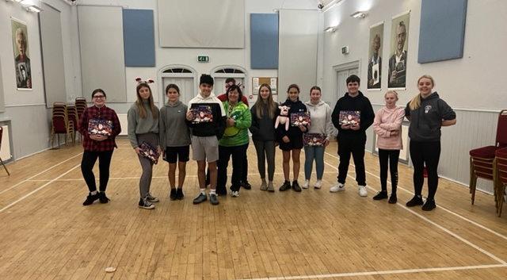
Inspire 2022 Crew!

Slide 6
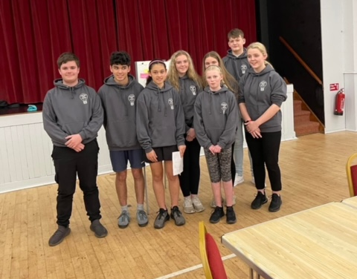
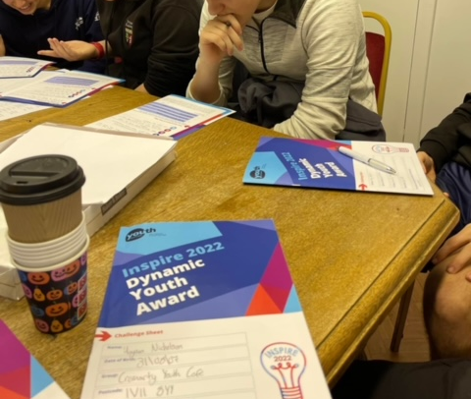
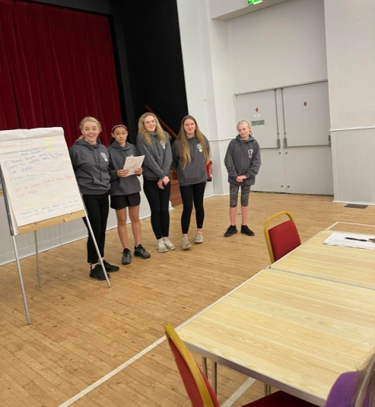
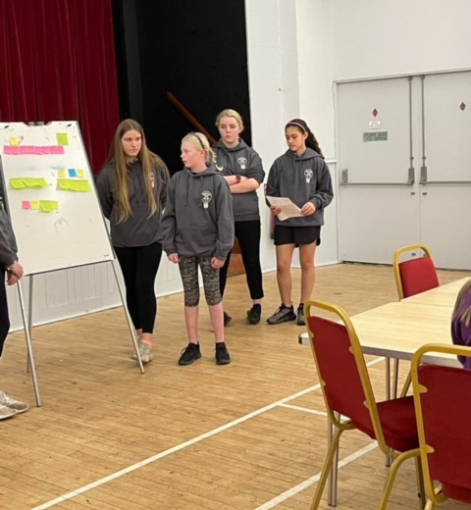

Slide 7
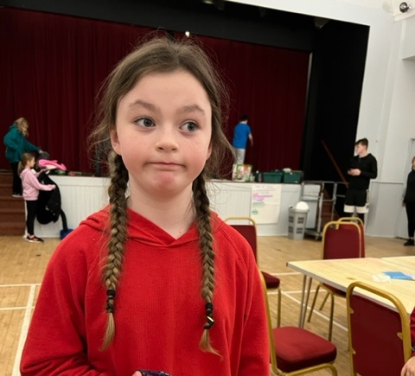
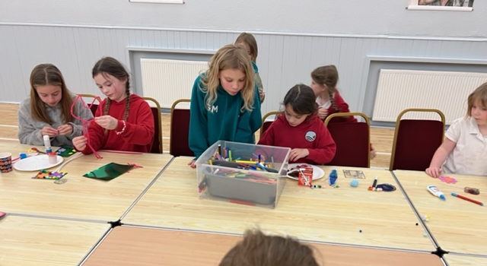
Jnr Christmas Crafts
On the lead up to Christmas there was a Christmas arts & craft session planned for the jnrs.

Slide 8
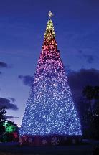
Jnr Lego Themed Christmas Party
This was the final session of the year, the session was planned and delivered by the Inspire 2022 Youth Crew – funding received from Youth Scotland.
There was also a special guest for the evening.
Feedback from parents on next slide

Slide 9
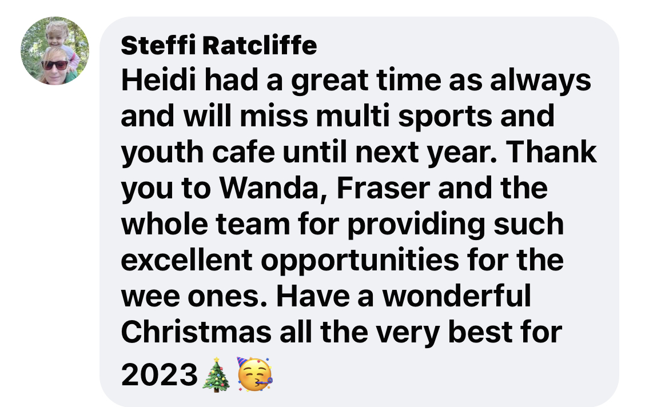
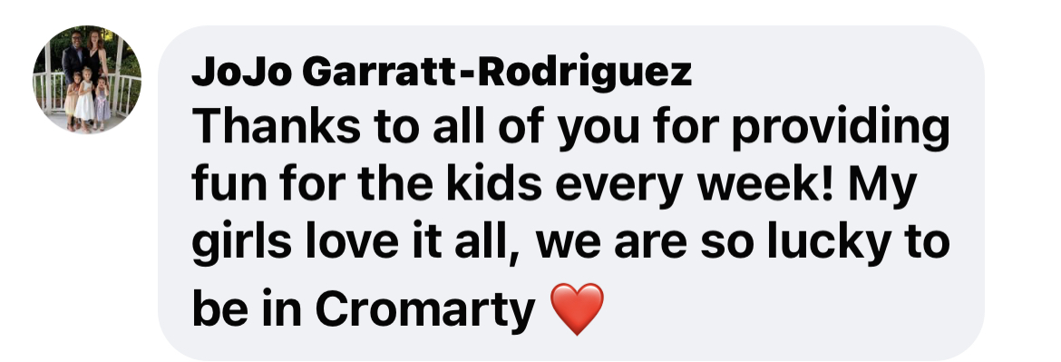
Feedback from Parents

Slide 10
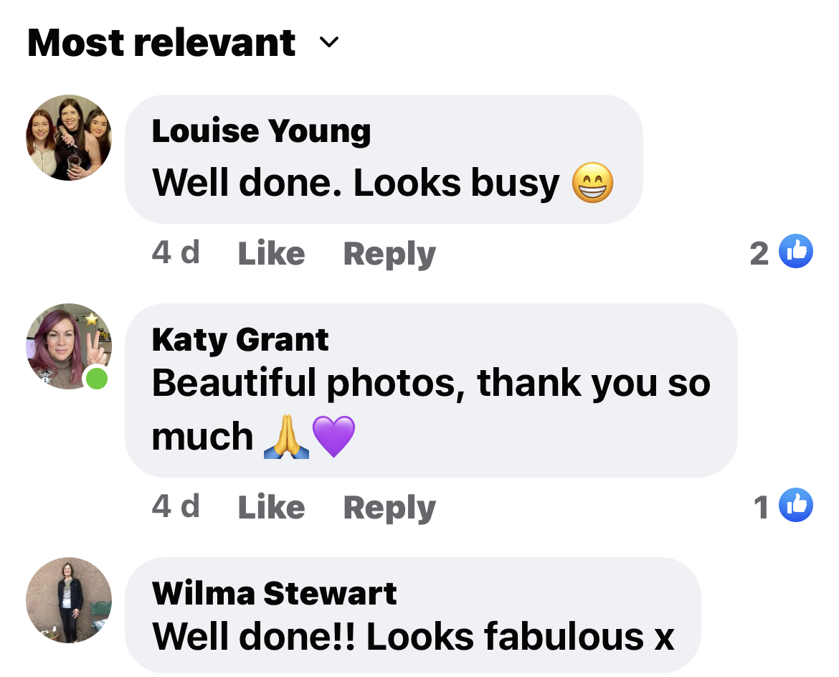
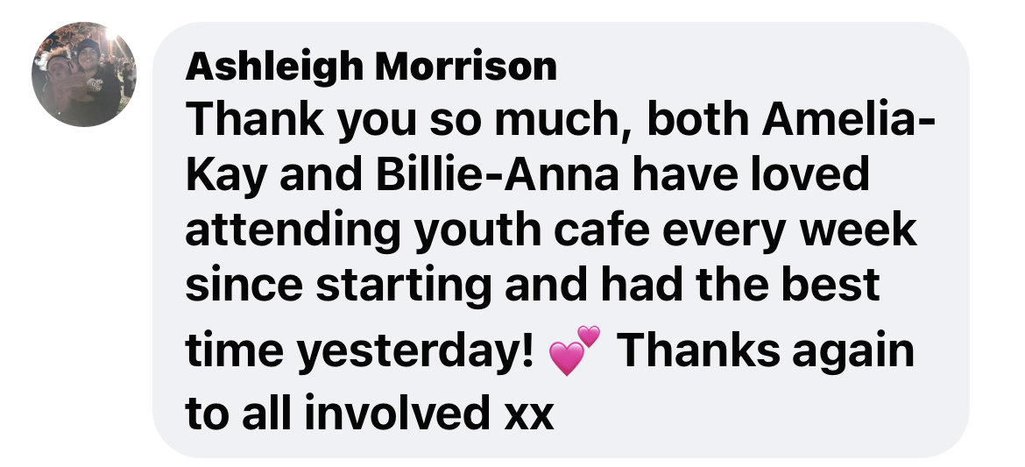

Slide 11
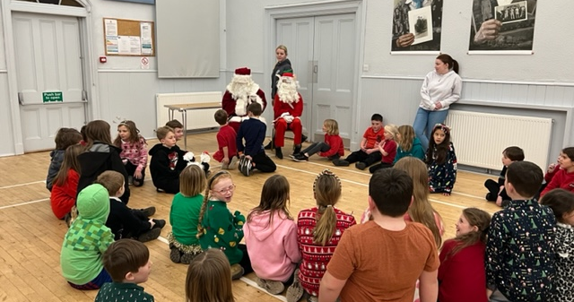

Slide 12
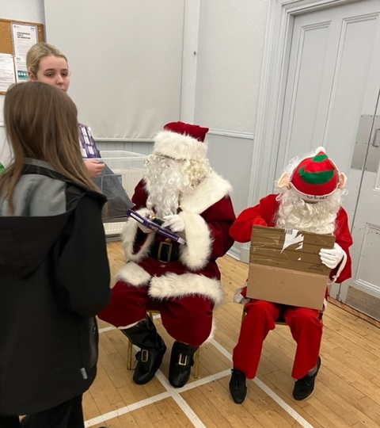
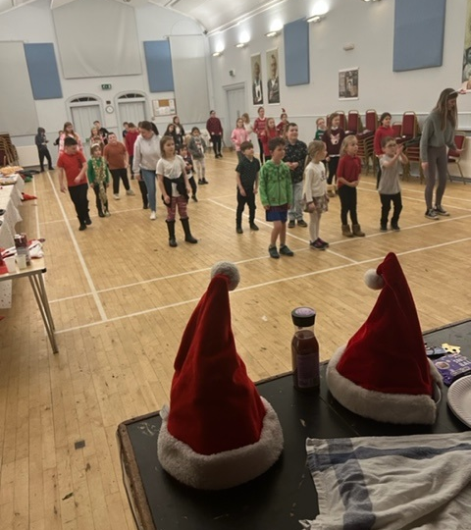

Slide 13
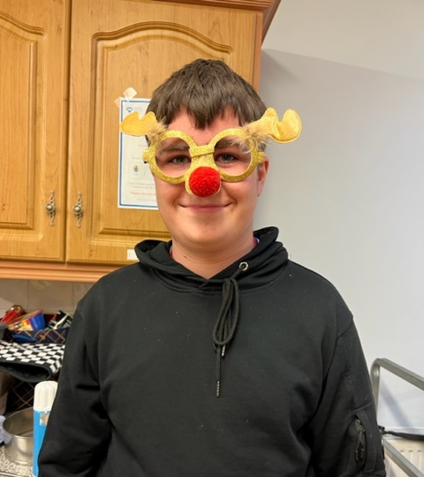
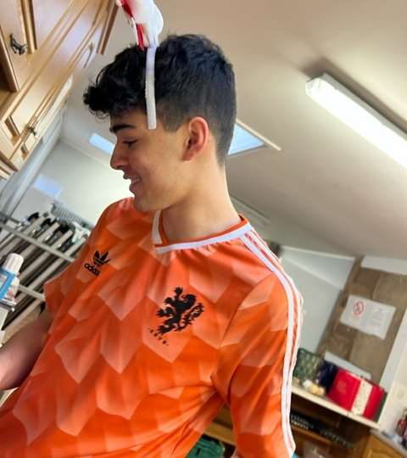

Slide 14
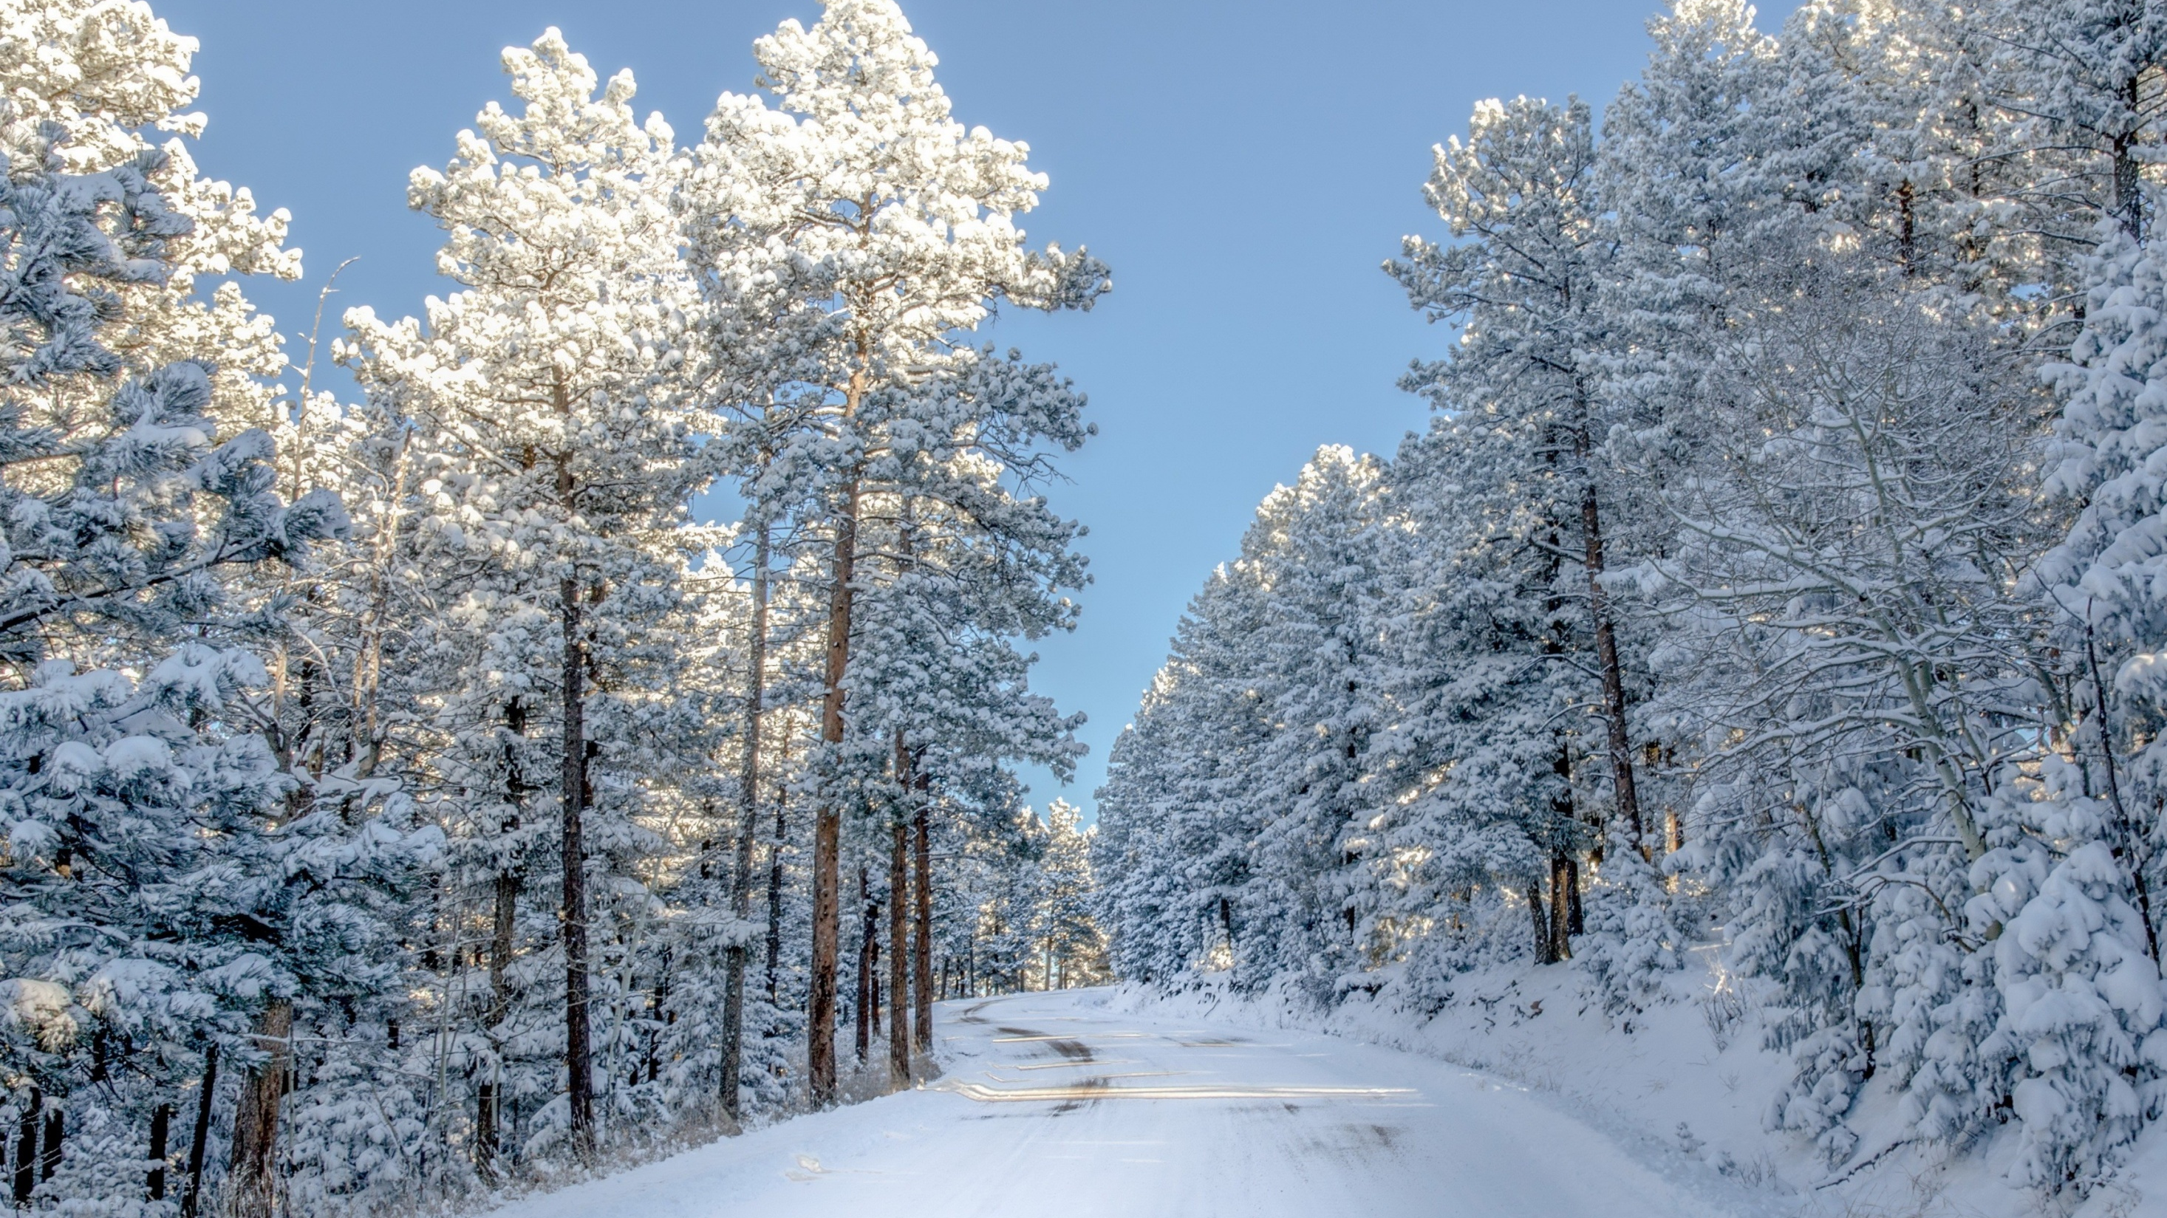
Winter Warm Bags
Part of our Inspire 2022 funding application was to offer support for older people in the community so we could supply them with a Winter WARM bag these bags would cost around £20 per person , our YP did an amazing pitch SUCCESS and so were able to make our bags with
Fluffy Socks,
Hat , Scarf
Gloves
Hot Water Bottles with warm covers
Different items of food
Sweet treats
Candle
Cheese and Biscuits
Handmade Christmas pudding Pom Poms made by Georgia.

Slide 15
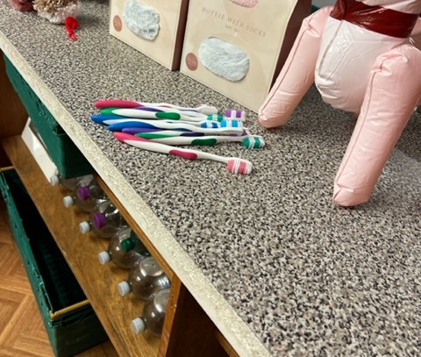
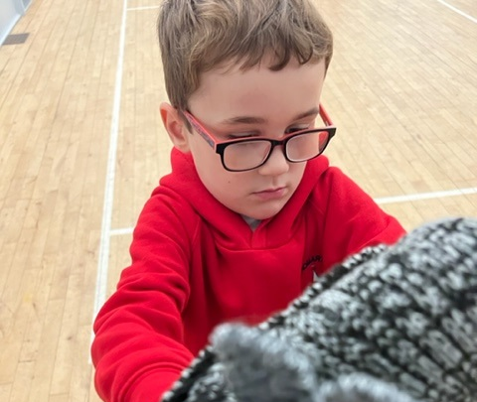
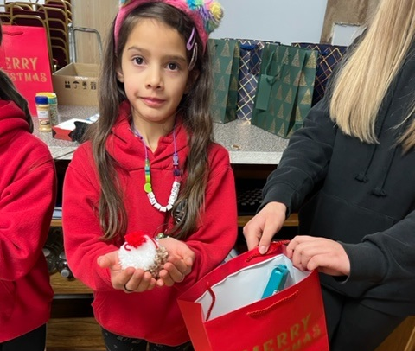
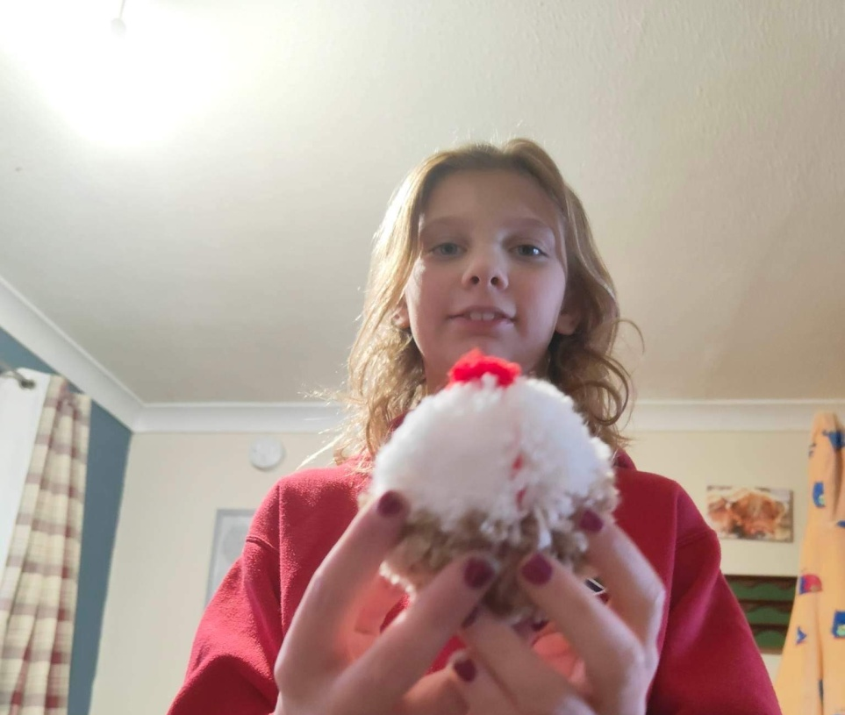
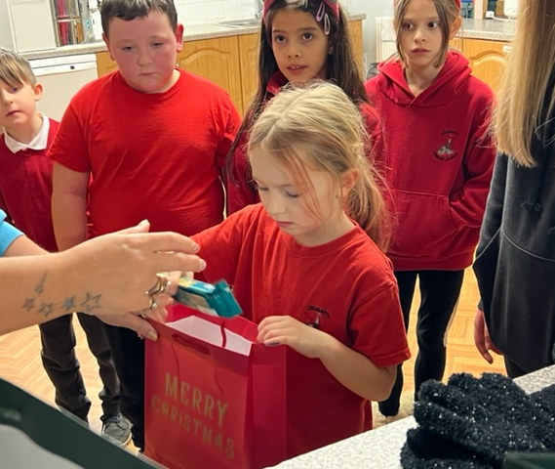
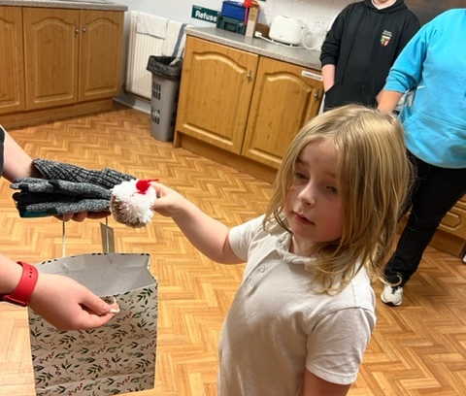

Slide 16
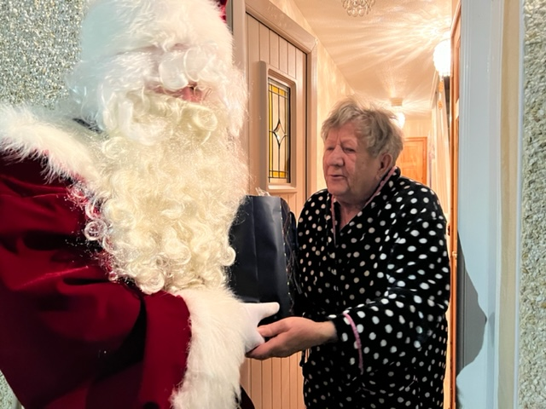
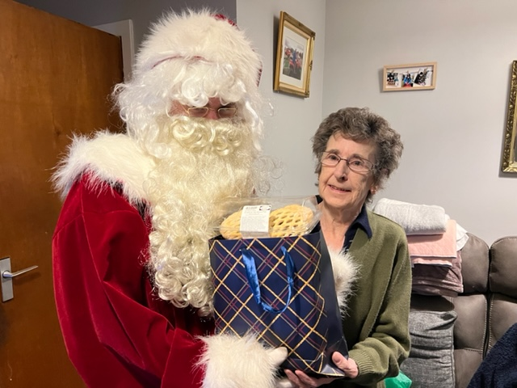
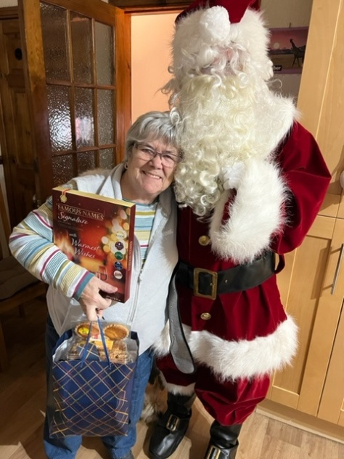
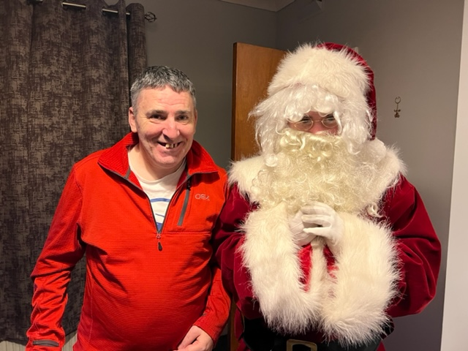
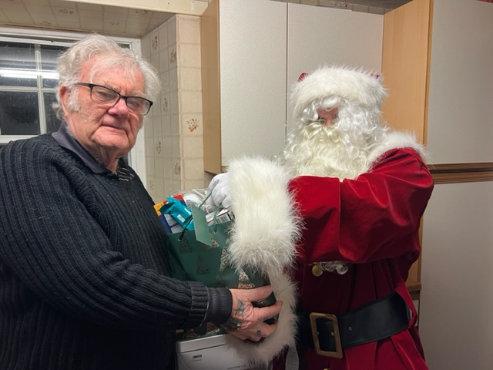
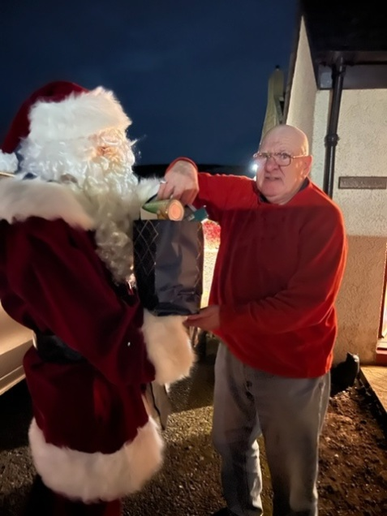

Slide 17
Cfine
With successful partnership with Cfine we are now a collection point for Sanitary Products -
During December we hosted the Press & Journal Newspaper at our Christmas party, they spoke to the all the young people about the benefits of the partnership with Cfine and the difference the deliveries make to Cromarty Youth Café participants and our golden oldies.
https://www.pressandjournal.co.uk/fp/news/highlands-islands/5133775/cromarty-youth-cafe-teaches-young-people-life-skills-thanks-to-cfine/?fbclid=IwAR1xHHt3Os5UjJWlvbkx97Y1FyWreV3H0xOoiOAQXSUJ79UJQgphVx3Fu1U

Slide 18
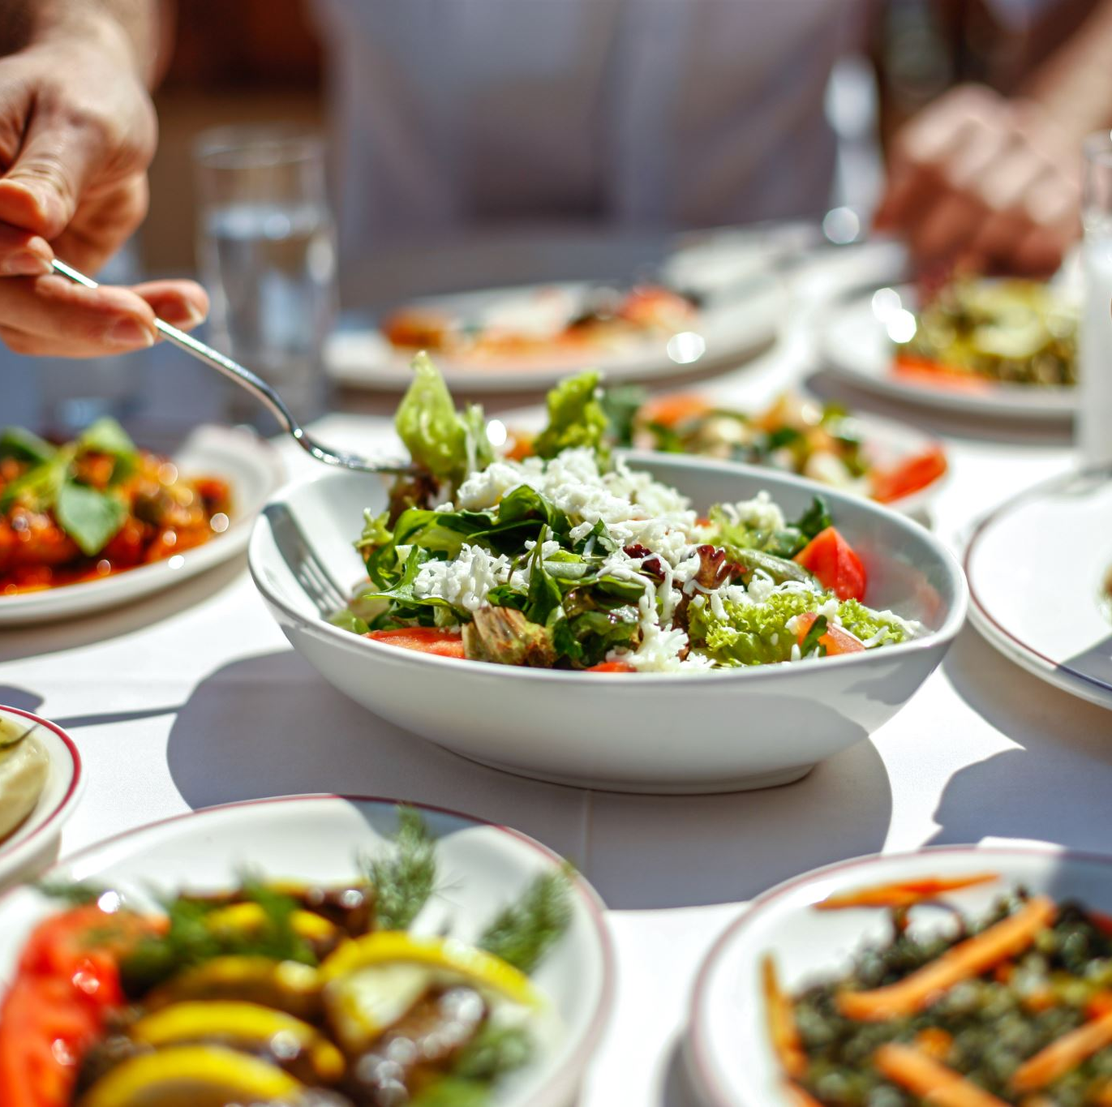
FOOD!
At every activity young people are given the opportunity to have access to fresh wholesome meals and snacks of their choice.
Meals and snacks are created by both jrns & snrs, all young people love taking part in Cookwell & Bakewell – gaining skills for life.
A number of YP have completed their Level 1 & Level 2 Food Safety at work courses with us, these courses take around 8-12 hours per person, be blend this with practical cooking.

Slide 19
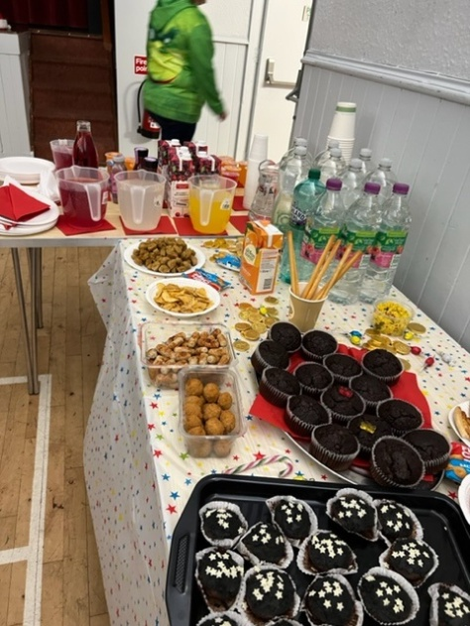
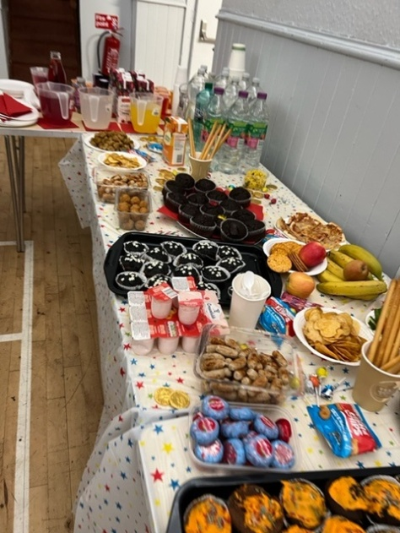
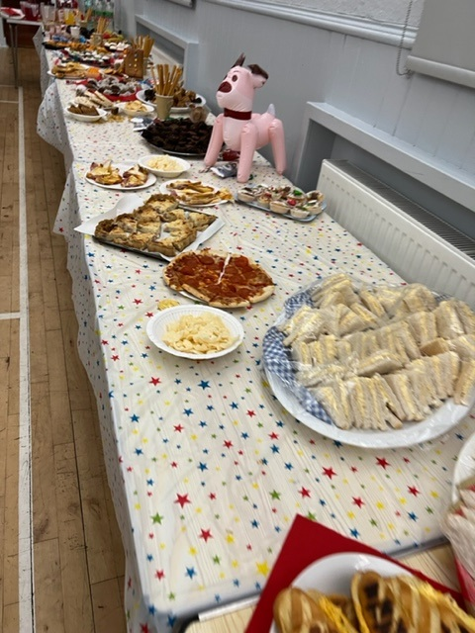
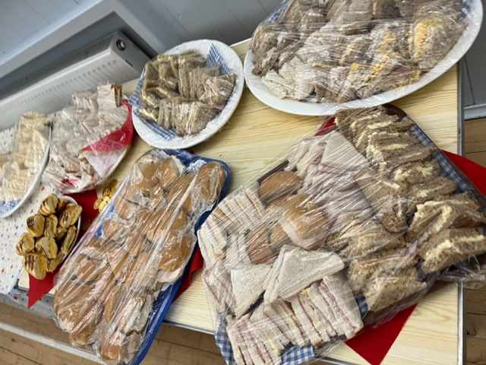
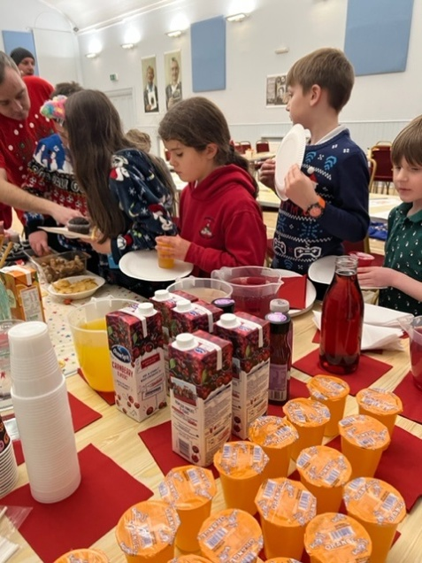

Slide 20
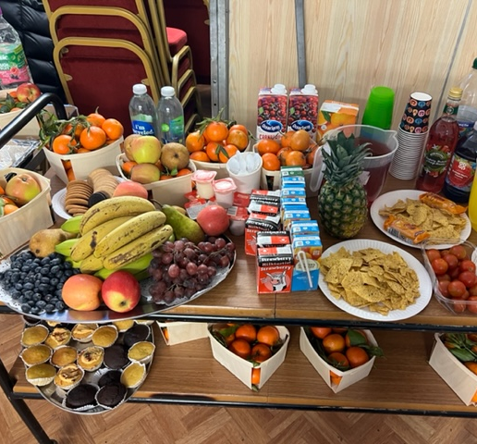
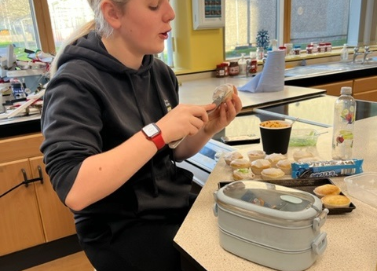
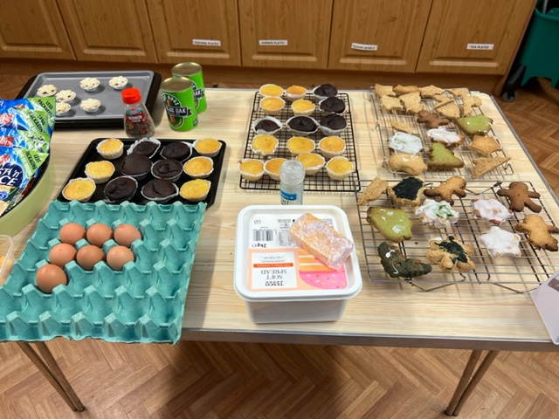

Slide 21
Saltire Awards & HLH Leadership
A number of young people from Cromarty are signed up for Saltire Awards & HLH Leadership programme:
Young people volunteer and lead at many different sessions weekly, such as, Multi-Sports, Jnr Youth Café, Football, Leading sessions on a Friday afternoon at Cromarty Primary School,
These young people are youth ambassadors.

Slide 22
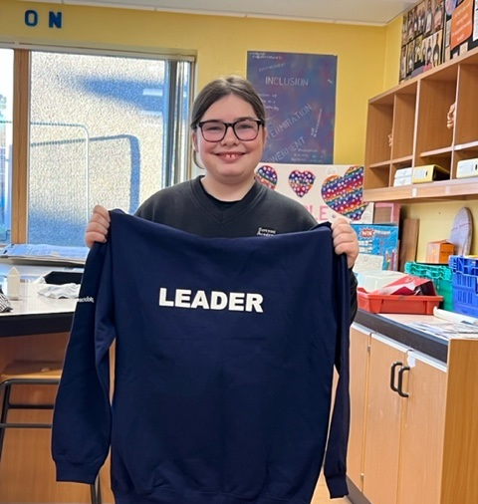
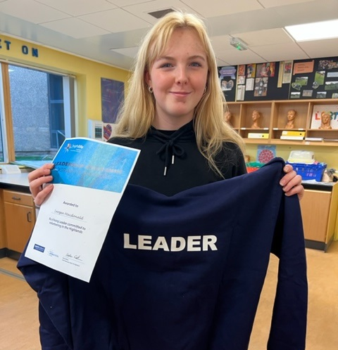
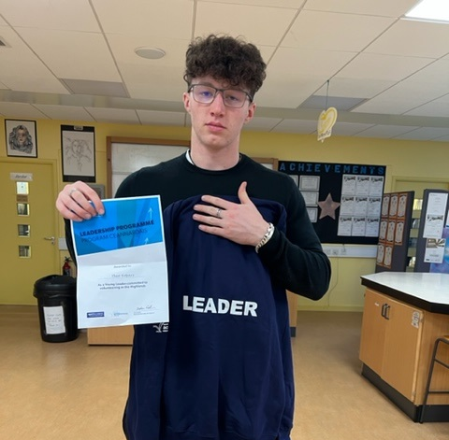

Slide 23
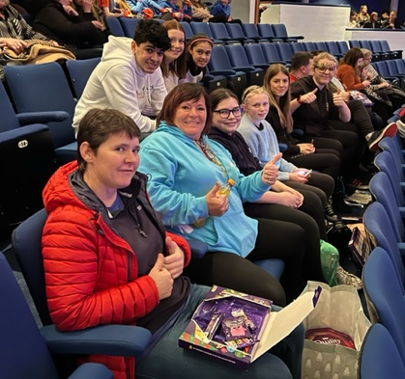
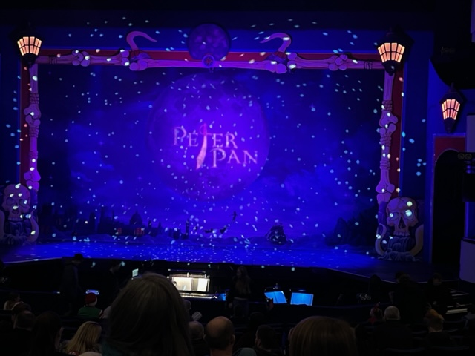
Trip to Eden Court Pantomime to see Peter Pan
This trip was a Thank you to our Young Leaders / Volunteers for their hard work through out the year.
One young person Said “ This was a childhood dream of mine to be able to go and see Peter Pan Pantomime”.

Slide 24
Partnership Development
Meeting with Yvonne Ross from Highland Council Safeguarding and partnership Team about funding.
Meeting with Lexi Mackay from Culloden Youth Development
Youth Scotland for the Inspire 2022 Funding
Mike & Jason at Cfine – Our food deliveries & Sanitary Products
Youth Highland – for Wider Achievement – Dynamic Youth Award
Fortrose Academy
Police Scotland – Wanda has had a number of meetings with Inspector Judy Hill – about the recent going on’s at the Kessock Bridge and the number of young people coming to us looking for support with their mental health.
Social Work

Slide 25
1-1’s
1-1’s are being requested daily,
Now more than ever having 1-1’s with young people is important:
Prelim Pressures
Cost of Existing – YP are worried about the rising costs at home,
Stress with the school bus being late and being late for school and then being late for prelims
Young people stressing about being in the lowest 20% in school.

Slide 26
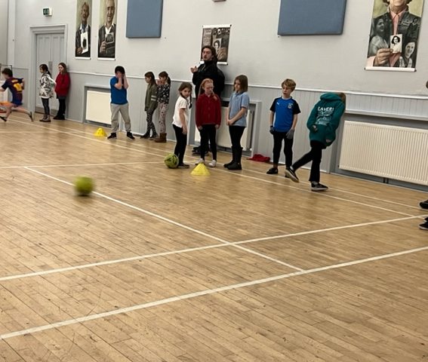
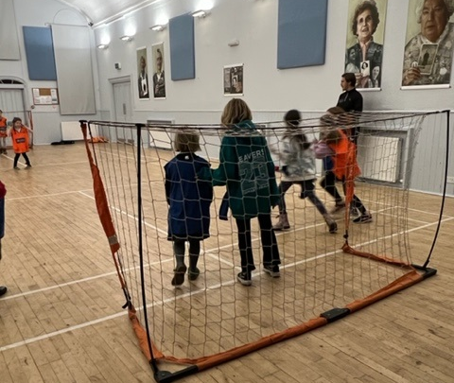
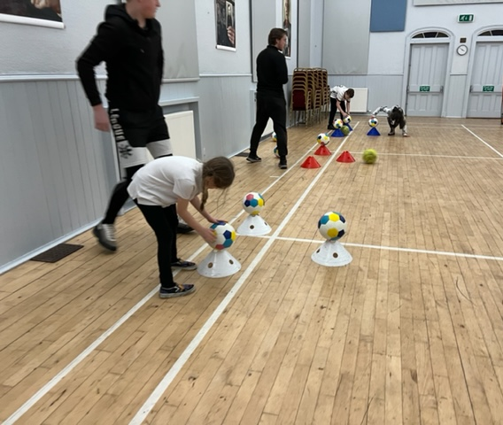
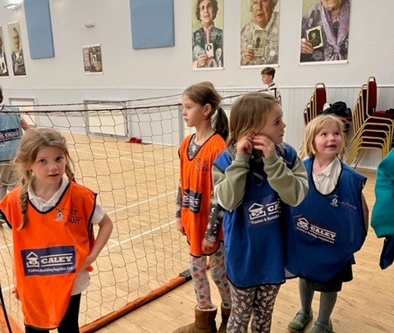
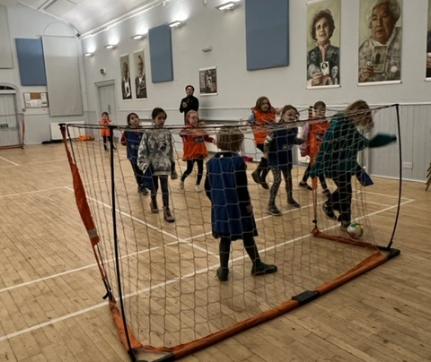
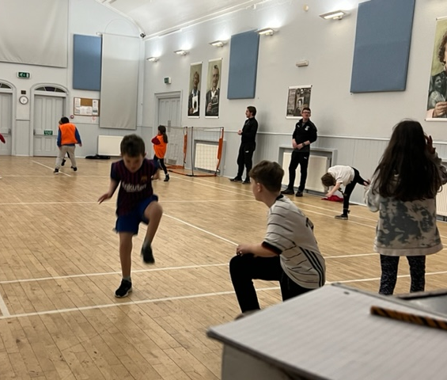
Football Coaching with ICT!

Slide 27
Funding
Wanda’s has spent a great deal of time each month , doing funding application sand feedback to funders, to support and sustain the Youth Café and all the activities the young people enjoy taking part in, that are all provided all year round FREE.
We have recently been awarded funding from The Corra Foundation to give vulnerable families support with a £50 voucher Food and £50 Fuel Voucher for 6 month’s
We delivered a number of sacks of presents from MFR Cash for Kids, along with Warm Winter Clothing.
Application Success with HC Cost of Living to support with YC Staffing Costs, Cookwell, Bakewell & Easter Programme.
All activities are planned in consultation with young people as we are a youth led project.

Slide 28
Activities up and coming in 2023
Returning to Youth Café Activities
New Athletics Club Starting Monday 6th Feb
Creativity in Care Intergenerational Puppets Workshops Starting Wed 22nd Feb
Inservice Day and Holiday Programmes.
Wider Achievement – taking part in any of the 55 different courses we have on offer
Supporting Young people to take part in Saltire Awards & HLH Leadership Programme
Well-being bag deliveries
And so much more!

Slide 29
If you would like anymore information please get in contact with myself.

